Slide 1




Python Error Handling
Handle unexpected issues during code execution. Prevent program crashes and maintain smooth flow.
by Aravind K
Notes:
1

Slide 2

What is Error Handling?
1
Unexpected Issues
2
Program Stability
3
User Experience
Errors can occur at runtime, disrupting normal execution.
Error handling keeps the program running even with errors.
Provides informative messages and prevents crashes.
Notes:
2

Slide 3
Try-Except Block
Try Block
Except Block
Contains code that might cause errors.
Executes if an error occurs in the try block.
Notes:
3

Slide 4




The Finally Block
Try-Except
Code to be executed.
Finally Block
Always executes after try-except.
Cleanup Actions
Resource release or closing operations.
Notes:
4

Slide 5

Raising Exceptions
Raise Keyword
Trigger an exception manually.
Custom Error Conditions
Define specific error types for your program.
Notes:
5

Slide 6
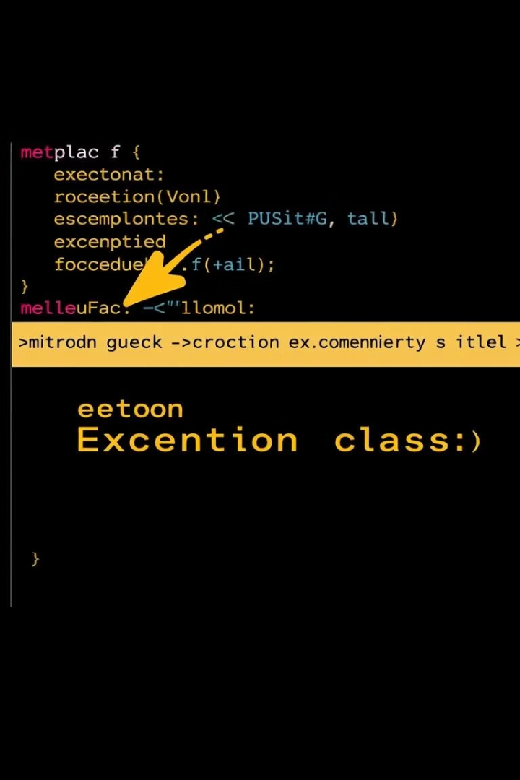
Custom Exceptions
Class Definition
1
Create new classes inheriting from Exception.
Specific Errors
2
Handle unique error types in your code.
Error Handling Flexibility
3
Tailored error management for your program.
Notes:
6

Slide 7
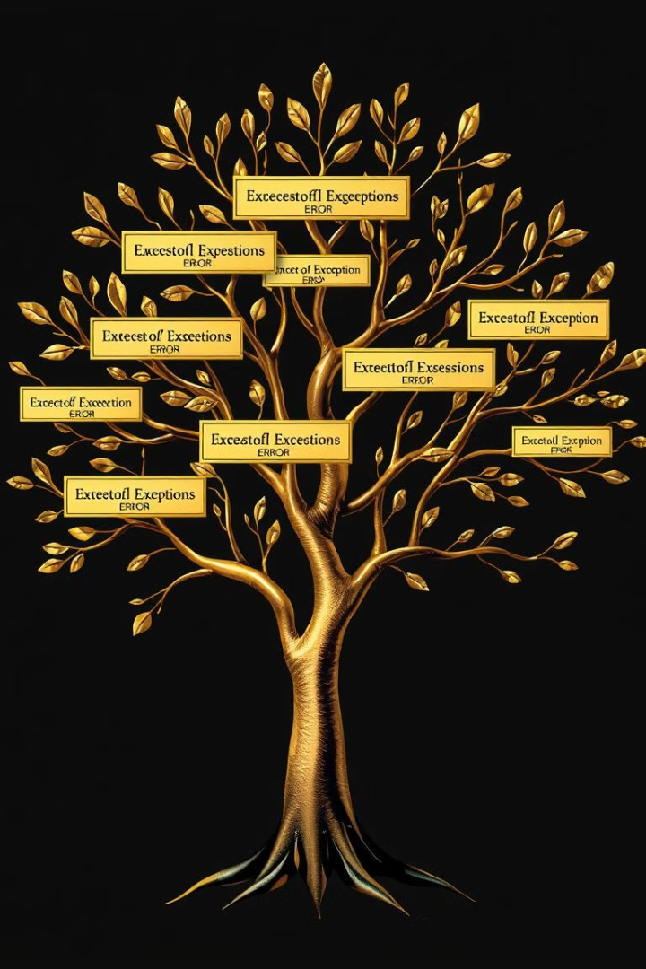
Handling Multiple Exceptions
Multiple Except Blocks
Handle different exceptions separately.
Parent Exception
Catch general errors with Exception.
Order Matters
Specific exceptions before general ones.
Notes:
7

Slide 8
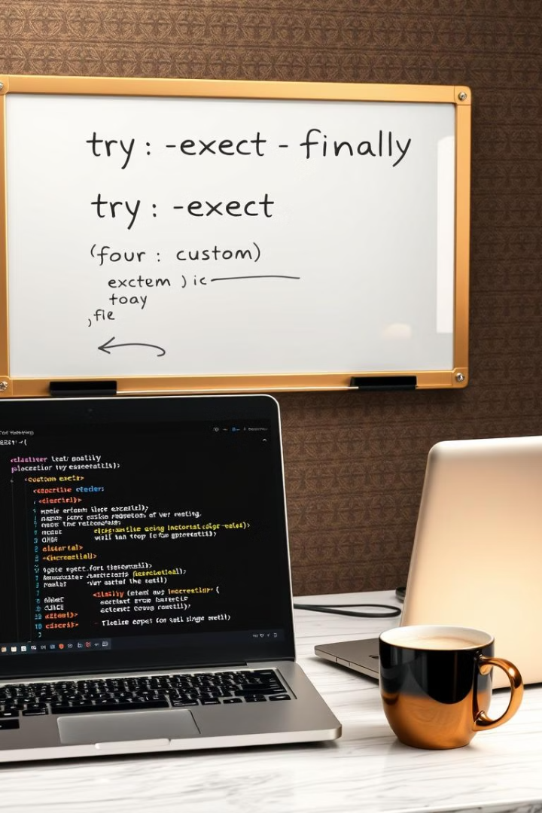



Key Takeaways
Smooth Execution
Prevent program crashes and ensure stability.
Effective Tools
Try-except-finally blocks and custom exceptions.
Flexible Management
Tailor error handling to specific needs.
Notes:
8

